Slide 1

Lecture 04: Digital System Design
Dept. of Computer Sc. and Engg.
University of Rajshahi
www.ru.ac.bd
Dr. Mahboob Qaosar

Slide 2
Decoders
A combinational circuit that converts binary information from n coded inputs to a maximum 2^{n} coded outputs → n-to- 2^{n} decoder
n-to-m decoder, m ≤ 2^{n}
Examples: BCD-to-7-segment decoder, where n=4 and m=10

Slide 3
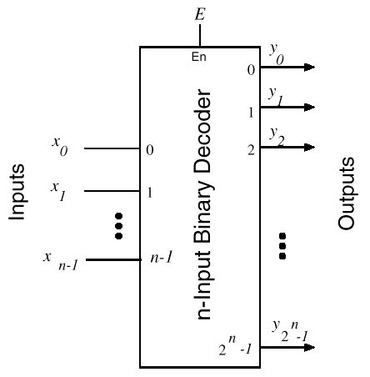
Decoders (cont.)

Slide 4
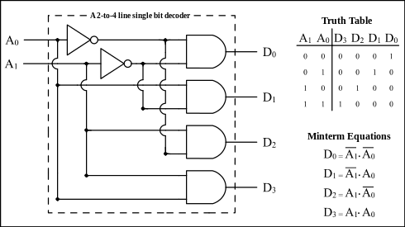
2-to-4 Decoder

Slide 5
3-to-8 Decoder
Three inputs, A₀, A₁, A₂, are decoded into eight outputs, D₀ through D₇
Each output D_{i} represents one of the minterms of the 3 input variables.
D_{i} = 1 when the binary number A₂A₁A₀ = i
Shorthand: D_{i} = m_{i}
The output variables are mutually exclusive; exactly one output has the value 1 at any time, and the other seven are 0.

Slide 6
The truth table of 3-to-8 Decoder
A2 | A1 | A0 | D0 | D1 | D2 | D3 | D4 | D5 | D6 | D7
0 | 0 | 0 | 1
0 | 0 | 1 |  | 1
0 | 1 | 0 |  |  | 1
0 | 1 | 1 |  |  |  | 1
1 | 0 | 0 |  |  |  |  | 1
1 | 0 | 1 |  |  |  |  |  | 1
1 | 1 | 0 |  |  |  |  |  |  | 1
1 | 1 | 1 |  |  |  |  |  |  |  | 1

Slide 7
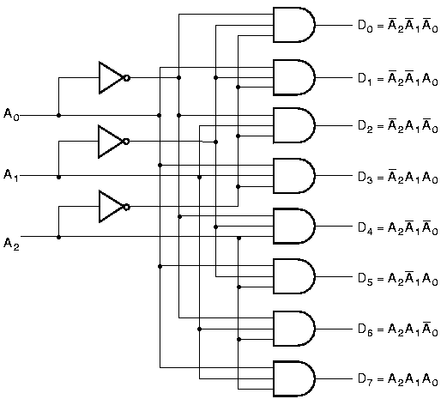
3-to-8 Decoder

Slide 8
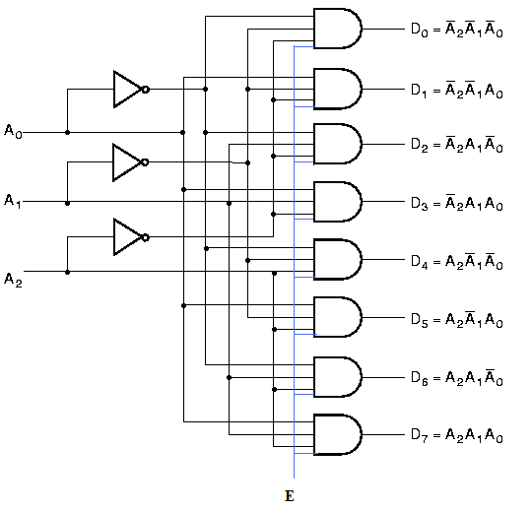
3-to-8 Decoder with Enable

Slide 9
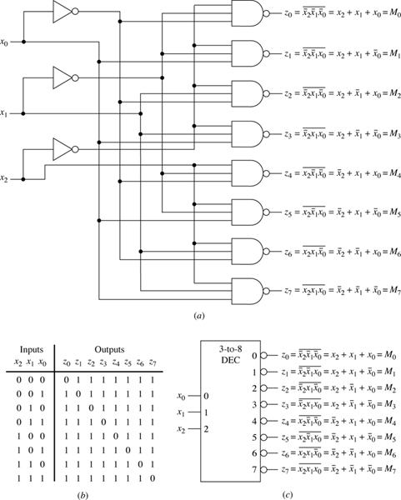
3-to-8-line decoder using nand-gates

Slide 10
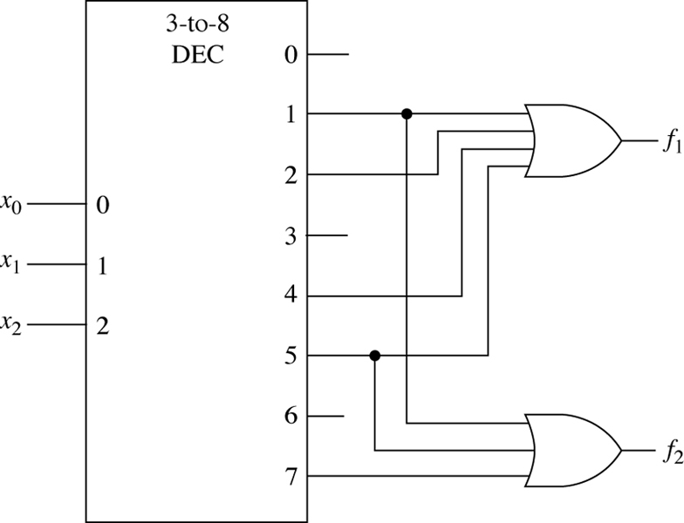
Implementation of the Boolean expressions f1(x2,x1,x0) = Σm(1,2,4,5) and f2(x2,x1,x0) = Σm(1,5,7) with a 3-to-8-line decoder and two or-gates.

Slide 11
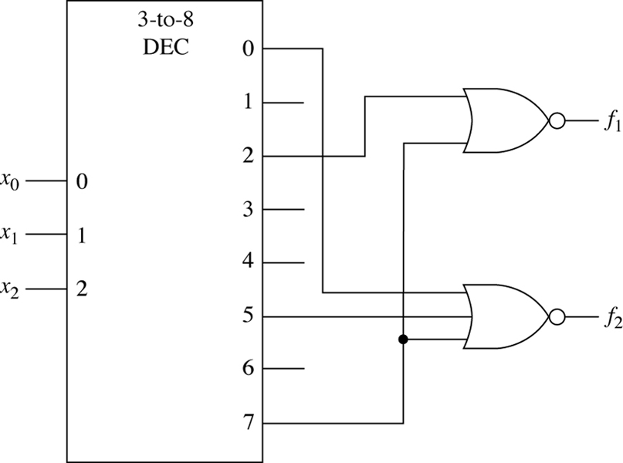
Implementation of the Boolean expressions f1(x2,x1,x0) = Σm(0,1,3,4,5,6) = !Σm(2,7) and f2(x2,x1,x0) = Σm(1,2,3,4,6) = !Σm(0,5,7) with a 3-to-8-line decoder and two nor-gates.

Slide 12
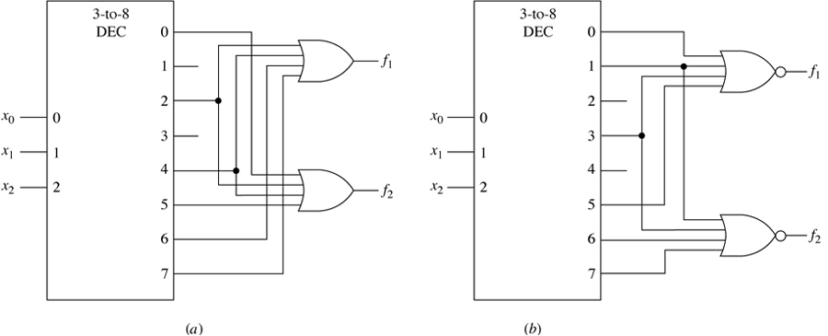
f1(x2,x1,x0) = ΠM(0,1,3,5) f2(x2,x1,x0) = ΠM(1,3,6,7) (a) Using output or-gates. (b) Using output nor-gates.

Slide 13
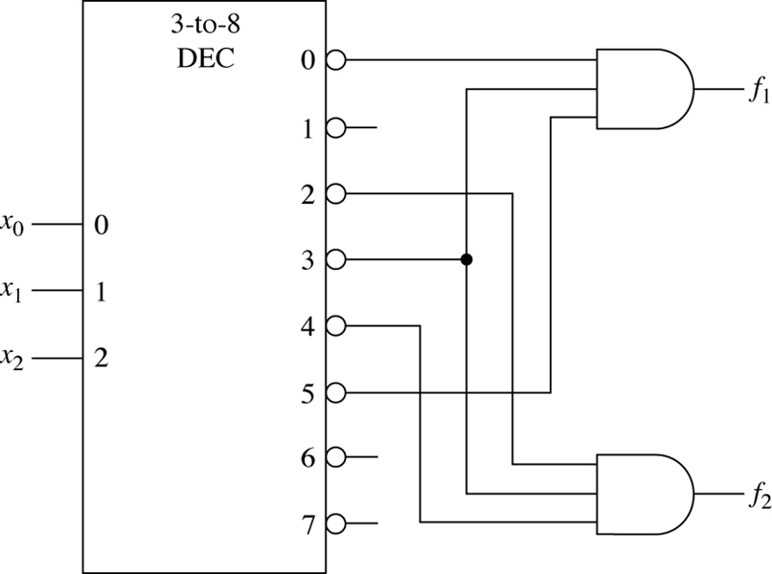
Realization of the pair of maxterm canonical expressions f1(x2,x1,x0) = ΠM(0,3,5) and f2(x2,x1,x0) = ΠM(2,3,4) with a 3-to-8-line decoder and two and-gates

Slide 14
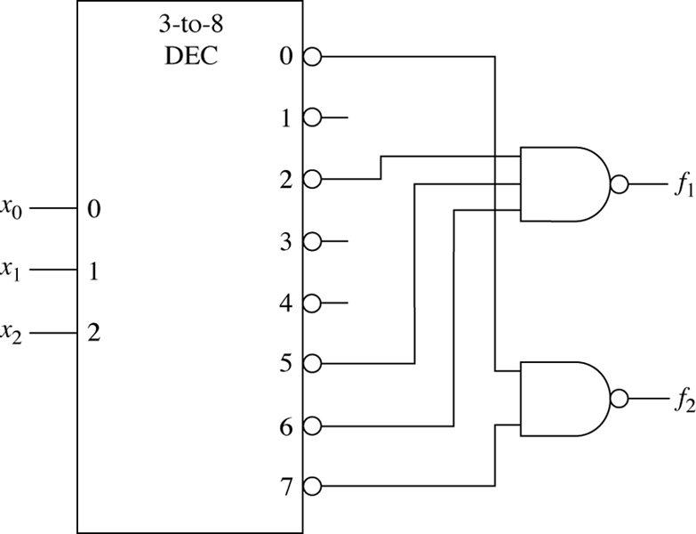
Realization of the Boolean expressions f1(x2,x1,x0) = ΠM(0,1,3,4,7) = !ΠM(2,5,6) and f2(x2,x1,x0) = ΠM(1,2,3,4,5,6) = !ΠM(0,7) with a 3-to-8-line decoder and two nand-gates.

Slide 15
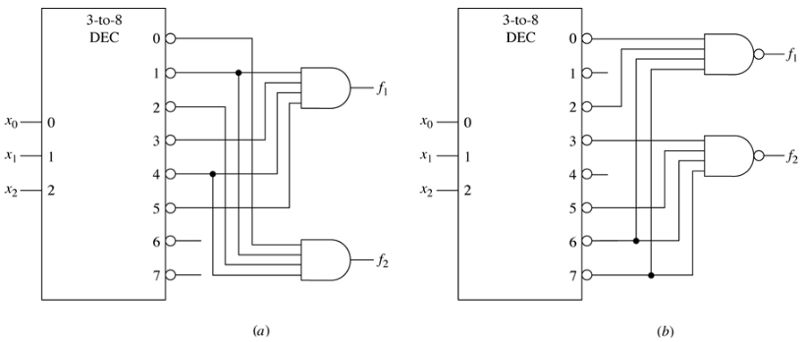
A decoder realization of f1(x2,x1,x0) = Σm(0,2,6,7) and f2(x2,x1,x0) = Σm(3,5,6,7) (a) Using output and-gates. (b) Using output nand-gates.

Slide 16
Implementation of the Boolean expressions
E.g. use 74XX138,3-to-8 decoder to implement boolean functions
Y₁=A’B’+AC+A’C’
Y₂=A’C+AC’
Y₃=B’C+BC’

Slide 17
Implementation of the Boolean expressions
Y₁=A’B’+AC+A’C’=m₀+m₁+m₂+m₅+m₇
= (m₀’m₁’m₂’m₅’m₇’)’
Y₂=A’C+AC’= m₁+m₃+m₄+m₆
= (m₁’m₃’m₄’m₆’)’
Y₃=B’C+BC’=m₁+m₂+m₅+m₆
= (m₁’m₂’m₅’m₆’)’

Slide 18
Implementation of the Boolean expressions
Y₁= (m₀’m₁’m₂’m₅’m₇’)’
Y₂= (m₁’m₃’m₄’m₆’)’
Y₃= (m₁’m₂’m₅’m₆’)’

Slide 19
Implementation of the Boolean expressions
Y₁=A’B’+AC+A’C’=m₀+m₁+m₂+m₅+m₇
=∑(0,1,2,5,7)
=∏(3,4,6)=M₃M₄M₆=m₃’m₄’m₆’
Y₂=A’C+AC’= m₁+m₃+m₄+m₆
=m₀’m₂’m₅’m₇’
Y₃=B’C+BC’=m₁+m₂+m₅+m₆
=m₀’m₃’m₄’m₇’

Slide 20
Implementation of the Boolean expressions
Y₁=m₃’m₄’m₆’
Y₂=m₀’m₂’m₅’m₇’
Y₃=m₀’m₃’m₄’m₇’

Slide 21
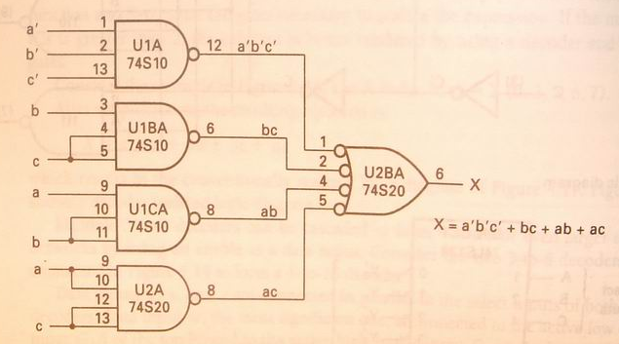
Implementation of the Boolean expressions
e.g. X=f(a,b,c)=∑(0,3,5,6,7)
=a’b’c’+ab+bc+ac

Slide 22
Implementation of Binary Adder Using a Decoder
Another example: Recall full adder equations, and let X, Y, and Z be the inputs:
S(X,Y,Z) = Σm(1, 2, 4, 7)
C(X,Y,Z) = Σm(3, 5, 6, 7)
Since there are 3 inputs and a total of 8 minterms, we need a 3-to-8 decoder.

Slide 23
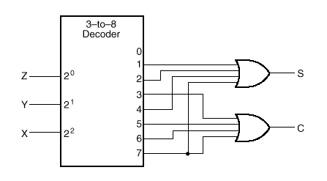
Implementation of Binary Adder Using a Decoder
S(X,Y,Z) = Σm(1,2,4,7)
C(X,Y,Z) = Σm(3,5,6,7)

Slide 24
Decoder Expansions
Larger decoders can be constructed using a number of smaller ones.
HIERARCHICAL design!
Example: A 6-to-64 decoder can be designed using four 4-to-16 and one 2-to-4 decoders. How? (Hint: Use the 2-to-4 decoder to generate the enable signals to the four 4-to-16 decoders).

Slide 25
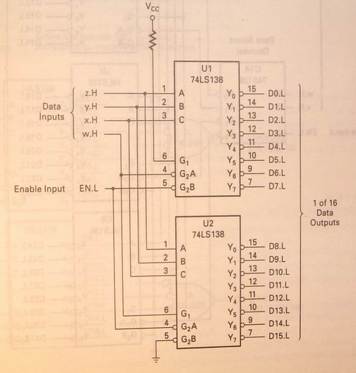
Decoder Expansions
Two 74XX138 decoders forming a single 4-to-16 decoder(P131)

Slide 26
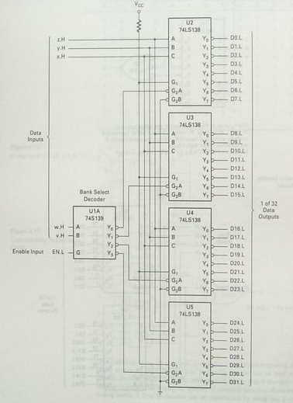
Decoder Expansions
A 5-to-32 decoder using one 2-to-4 and four 3-to-8 decoder ICs(P132)

Slide 27
Encoders
An encoder is a digital circuit that performs the inverse operation of a decoder. An encoder has 2^{n} input lines and n output lines.
The output lines generate the binary equivalent of the input line whose value is 1.

Slide 28
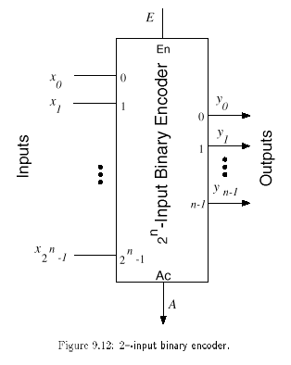
Encoders (cont.)

Slide 29
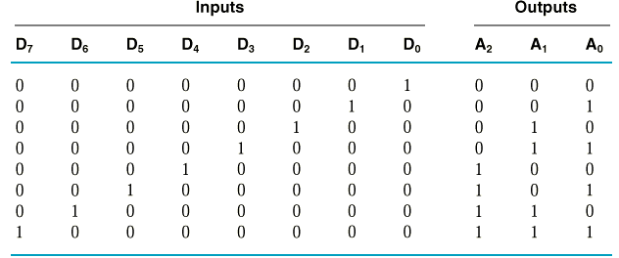
Encoder Truth Table
8-to-3 binary encoder (octal-to-binary)
A₀ = D₁ + D₃ + D₅ + D₇
A₁ = D₂ + D₃ + D₆ + D₇
A₂ = D₄ + D₅ + D₆ + D₇

Slide 30
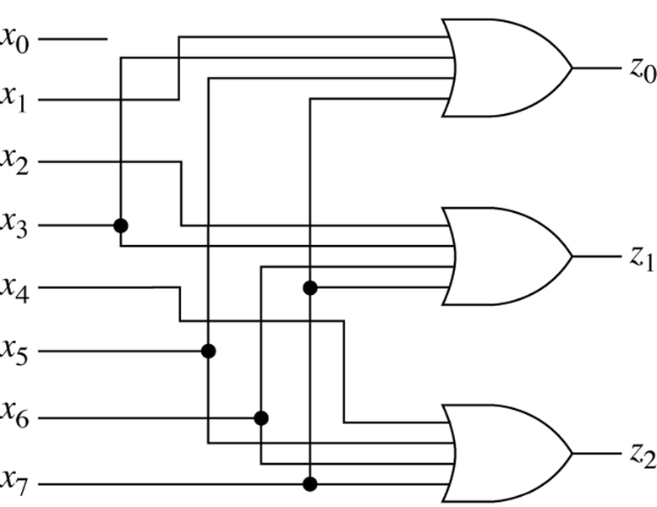
An 8-to-3-line encoder
y₀
y₁
y₂

Slide 31
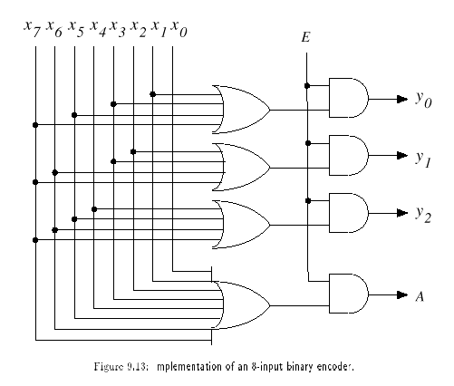
Encoder with active Flag
A = 1 if E = 1 and one x_{i} = 1, otherwise A = 0

Slide 32
Priority Encoder
Accepts multiple values and encodes them
Works when more than one input is active
Consists of:
Inputs (2^{n})
Outputs
when more than one output is active, sets output to correspond to highest input
V (indicates whether any of the inputs are active)
Selectors / Enable (active high or active low)
Notes:
32

Slide 33
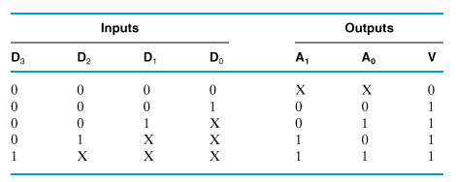
Example: 4-to-2 Priority Encoder Truth Table

Slide 34
4-to-2 Priority Encoder Truth Table
D3 | D2 | D1 | D0 | A1 | A2 | V
0 | 0 | 0 | 0 | x | X | 0
0 | 0 | 0 | 1 | 0 | 0 | 1
0 | 0 | 1 | 0 | 0 | 1 | 1
0 | 0 | 1 | 1 | 0 | 1 | 1
0 | 1 | 0 | 0 | 1 | 0 | 1
0 | 1 | 0 | 1 | 1 | 0 | 1
0 | 1 | 1 | 0 | 1 | 0 | 1
0 | 1 | 1 | 1 | 1 | 0 | 1
1 | 0 | 0 | 0 | 1 | 1 | 1
1 | 0 | 0 | 1 | 1 | 1 | 1
1 | 0 | 1 | 0 | 1 | 1 | 1
1 | 0 | 1 | 1 | 1 | 1 | 1
1 | 1 | 0 | 0 | 1 | 1 | 1
1 | 1 | 0 | 1 | 1 | 1 | 1
1 | 1 | 1 | 0 | 1 | 1 | 1
1 | 1 | 1 | 1 | 1 | 1 | 1

Slide 35
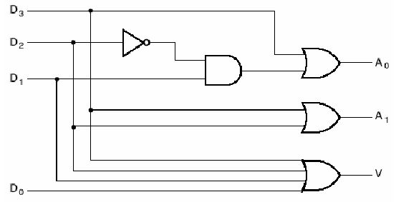
4-to-2 Priority Encoder

Slide 36
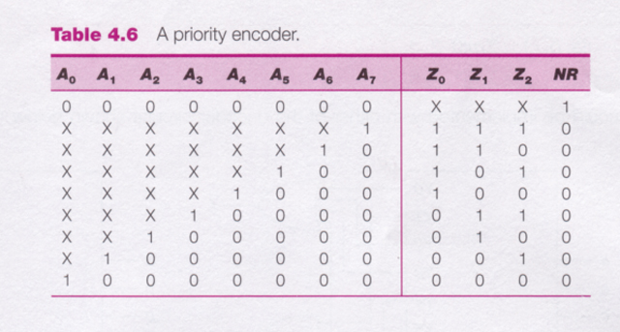
8-to-3 Priority Encoder

